Slide 1
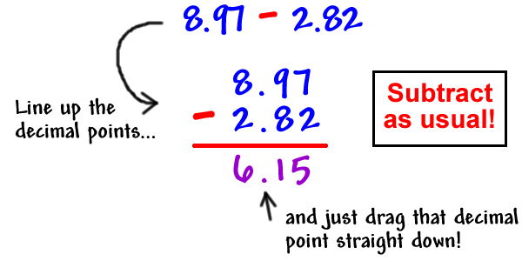
Topic 2: Add and Subtract Decimals to Hundredths
Vocabulary

Slide 2
Essential Questions:
How can sums and differences of decimals be estimated?
What are the standard procedures for adding and subtracting whole numbers and decimals?
How can sums and differences be found mentally?

Slide 3
Standards
5.NBT.B.7
5.NBT.A.4

Slide 4
compatible numbers
Compatible numbers are numbers that are easy to compute with mentally.
**Estimate 547 + 294
Think 547 is about 550
Think 294 is about 300
So 550 + 300 = 850

Slide 5
compensation
Compensation is adjusting one number to make a computation easier and balancing the adjustment by changing another number.
**Find 648 + 325 (add 2) = 650
650 + 325 = 975
**So, 648 + 325 = 973 (subtract 2)

Slide 6
Commutative Property of Addition
The Commutative Property of Addition states that addends can be added in any order and the sum remains the same.
6,283 + 4,129 = 4,129 + 6,283
10,412 = 10,412

Slide 7
Associative Property of Addition
The Associative Property of Addition states that addends can be regrouped and the sum remains the same.
243 + (157 +732) = (243 + 157) + 732
+ 889 = 400 + 732
1,132 = 1,132

