Slide 1
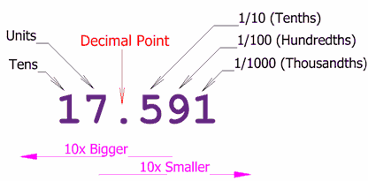
Topic 1: Understanding Place Value
Vocabulary

Slide 2
Essential Question:
How are whole numbers and decimals written, compared, and ordered?

Slide 3
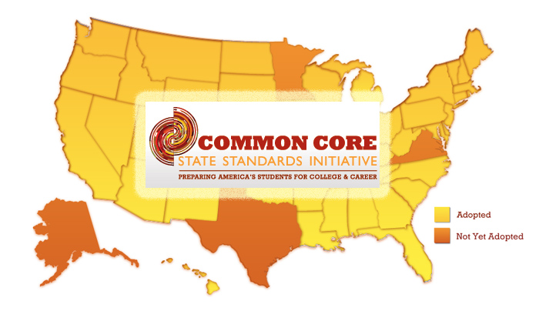
Standards
5.NBT.A.1
5.NBT.A.2
5.NBT.A.3a
5.NBT.A.3b
5.NBT.A.4

Slide 4
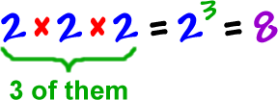
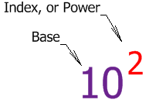
exponent
The exponent is the number that tells how many times a base number is used as a factor.

Slide 5
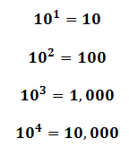
power
The product that results from multiplying the same number over and over is a power of that number.
10 x 10
10 x 10 x 10
10 x 10 x 10 x 10

Slide 6
base
When a number is written using exponents, the base is the number that is used as a factor.

Slide 7
value
The place of a digit in a number tells you its value.
5,318
The value of the 3 is 300.

Slide 8
expanded form
Expanded form is a way to write a number that shows the sum of each digit multiplied by its own place value.
5,319 = (5 x 1000) + (3 x 100) + (1 x 10) + (9 x 1)
24.875 = (2 x 10) + (4 x 1) + (8 x 1/10) + (7 x 1/100) + (5 x 1/1000)

Slide 9
thousandths
A thousandth is one out of 1,000 equal parts of a whole.
3.584
4 is in the thousandths place.

Slide 10
Equivalent decimals
Decimals that name the same part of a whole are called equivalent decimals.
0.7 = 0.70

