Slide 1
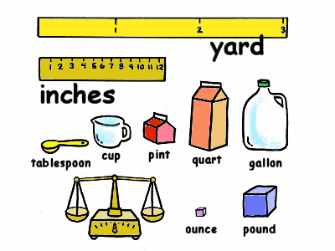
Topic 11: Convert Measurements Vocabulary

Slide 2
Essential Questions:
What are customary measurement units and how are they related?
What are metric measurement units and how are they related?

Slide 3
Standards
5.MD.A.1
5.MD.A.2
5.NBT.B.5
5.NBT.B.6

Slide 4
foot
A customary unit of length equal to 12 inches is a foot.
1 foot = 12 inches

Slide 5
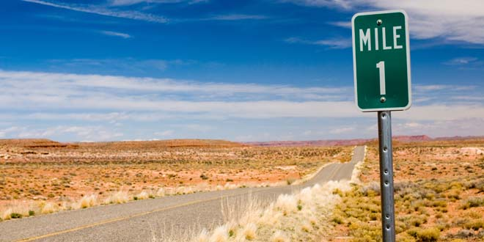
mile
A customary unit of length equal to 5,280 feet is a mile.
1 mile = 5,280 feet

Slide 6
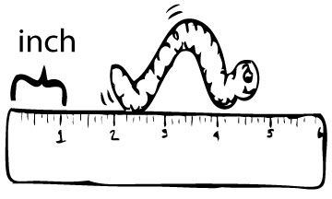
inch
A customary unit of length less than 1 foot is an inch.
12 inches = 1 foot

Slide 7
yard
A customary unit of length equal to 3 feet is a yard.
1 yard = 3 feet

Slide 8
capacity
Capacity is the volume of a container measured in liquid units.

Slide 9
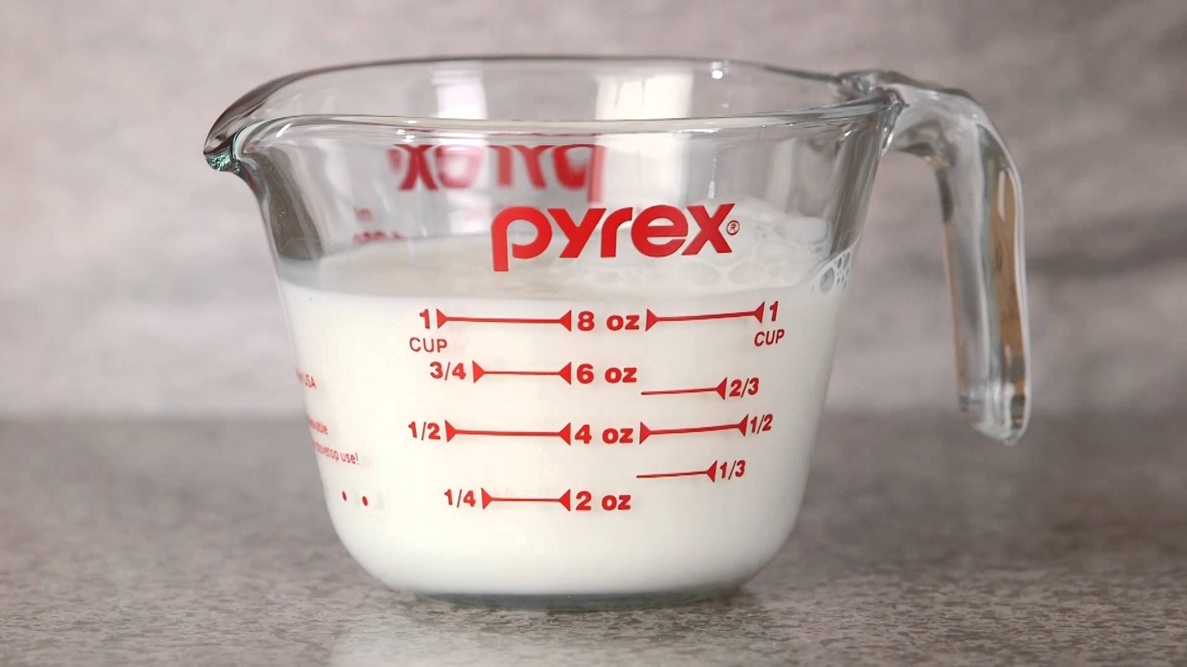
cup
A customary unit of capacity equal to 8 fluid ounces is a cup.
1 cup = 8 fluid ounces (oz.)

Slide 10
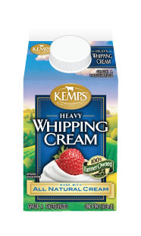
pint
A customary unit of capacity equal to 2 cups is a pint.
1 pint = 2 cups

